Slide 1
AIM6140: Health Informatics
EHR and PHR and system
implementation

Slide 2
Benefits and challenges of EHR
Benefits
  Improved patient care
  Personal health records
  Data science and artificial intelligence
  Clinical decision support
  Quality measurement and improvement
  Health information exchange
  Clinical research
  Improved nursing care
  Public health
Challenges
  Data quality
  Data usability
  Data entry
  Standards and interoperability
  Understanding clinical narrative text
  Privacy, confidentiality, and security
  Implementation

Slide 3
Personal health records
Definitions
Approaches and examples
Next steps

Slide 4
Personal health record (PHR) definition
“a record controlled by the individual and may include health information from a variety of sources, including multiple health care providers and the patients themselves. The PHR is separate from, and does not replace the legal record of any health care provider”

Slide 5
Benefits for stakeholders
Consumers, patients, and caregivers – support healthcare and wellness
Healthcare providers – improve care delivered
Payers – improve customer service
Employers – improve employee productivity
Society/population – strength health promotion and disease prevention

Slide 6
Types of PHRs
Tethered
  Stored in healthcare provider’s EHR
  Often allows communication with provider
  May allow patient to add information
Standalone
  Isolated application on individual computer – may use mobile device or Web site
Interconnected or integrated
  Separate application but integrated with provider EHR(s) for, e.g., test results, scheduling, data collection, etc.

Slide 7
Approaches and examples
Tethered
  Epic - MyChart
  myHealtheVet
Standalone
  WebMD Health Manager
Integrated
  Apple Health

Slide 8
Tethered PHRs
Typical functions include
  Allow viewing of patient’s data in EHR
  Patient able to communicate with healthcare provider for appointments, refills, and non-urgent questions
  Provide access to consumer-oriented library of health information
  Usually browser-based, but increasingly on mobile devices
Example: Epic MyChart
  Secure view into Epic EHR with additional patient-oriented functionality
  Available via Web and smartphone apps
  Provides access to all providers who use Epic

Slide 9
Integrated PHRs
Some notable failures
  Google Health
  Microsoft HealthVault
Apple Health – integrates health from many mobile apps
  Devices – e.g., blood pressure, fitness trackers
  Apps – e.g., fitness, health measurements
  EHR – Epic data (Mandl, 2018; Monica, 2018)
  In the smartphone era, the tipping point for PHR usage,

Slide 10
Next steps – patient control of their data?
Growing view that patients are owners and stewards of their data; should everyone have cloud-based data store with access granted to patient-chosen providers?
  Implications for current vendor-centric data storage, integrity of data, and cost model
  Patients can annotate but not alter data from healthcare system
Requirements
  Standard data elements
  Standard receipt for all data
  Contract that sets rules for access and control
Physicians and healthcare organizations “subscribe” to their patients’ data?

Slide 11
Data management
Databases store large amounts of information in structured and easily accessible format
Most biomedical applications require strong database capabilities
Database components
  Field – unit of data (e.g., heart rate, diagnosis)
  Record – collection of fields making an entry (e.g., patient demographics, chemistry panel)
  Table – collection of records of same type (e.g., all patients, all chemistry panels)
Common modern operation with data from varying sources is extract, transform, and load (ETL)

Slide 12
Database management systems (DBMS)
Computer programs that manage data and access to it, often with programming languages
Different DBMS models
  Flat-file – each and every record has same data
  Relational – most common model, queried via Structured Query Language (SQL)
  Entity-Attribute-Value (EAV) – more flexible structure for representing “sparse” data
  Hierarchical – non-relational, based on MUMPS programming language paradigm
Some fields can be indexed, which allows rapid look-up
  An essential feature for large databases of any type, usually done with B-Trees or hashing

Slide 13
Some DBMS terminology
Essential database operations (CRUD)
  Create record
  Read record
  Update record
  Delete record
Should meet ACID test
  Atomicity – each transaction discrete
  Consistency – data types consistent
  Isolation – handles concurrent transactions
  Durability – once committed, stays committed
Data warehouse – repositories of integrated data from one or more disparate sources
  Data mart is a subset of data warehouse extracted for specific analyses
Data lake – single store of an organization’s data in raw format

Slide 14
Relational DBMS
Relational model links records to tables – e.g., patients to test results or encounters
Allows efficiencies
  One-time information (e.g., demographics) stored only once
  Complex queries easier to construct and carry out
Most query capabilities are based on Structured Query Language (SQL)
  https://sqlzoo.net/

Slide 15
Simple relational database layout
Clinical Population
Patient 1
Result 1
Demographics and other one-time information
Result 2
Result 3
Patient 2
Encounter 1
Patient 3
Encounter 2
Encounter 3
Using SQL and JOIN command, we can:
Find all patients with Disease X and on Drug Y
Find all patients who are over Age X and have not had Test Y
Find all Test X results for patients with Disease Y

Slide 16
Hierarchical databases
Developed originally for medical applications
Original system was MGH Utility Multi-Programming System (MUMPS)
Used in early (COSTAR) and later (VistA, Epic) EHR systems
Later called M and now commercially maintained as Cache (Intersystems Corp.)
Highly efficient for transactions, less for queries across results and patients
  Analytical applications export to relational systems

Slide 17
Metadata – data about data
“Data about data” – meaning of data elements
Three types of metadata
  Descriptive – describes data element for discovery or identification
  Structural – describes organizational structure of data
  Administrative – information on how to manage
    Rights management – who can access and when, how, etc.
    Preservation – archiving and storage
Standard for metadata registries is ISO 11179 – http://metadata-standards.org/11179/

Slide 18
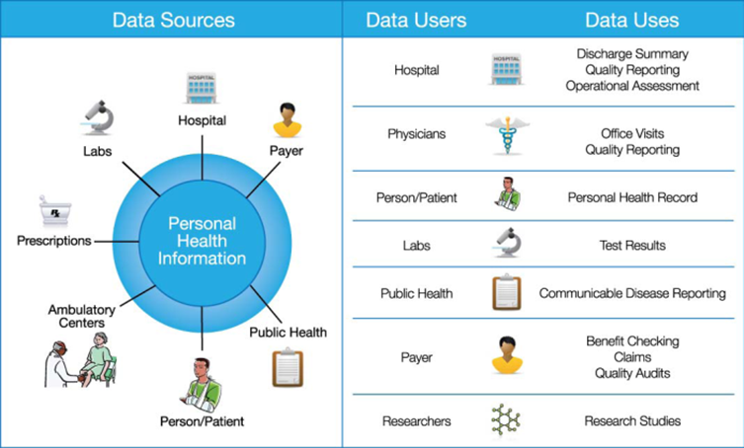
Many sources, users, and uses of clinical data

Slide 19
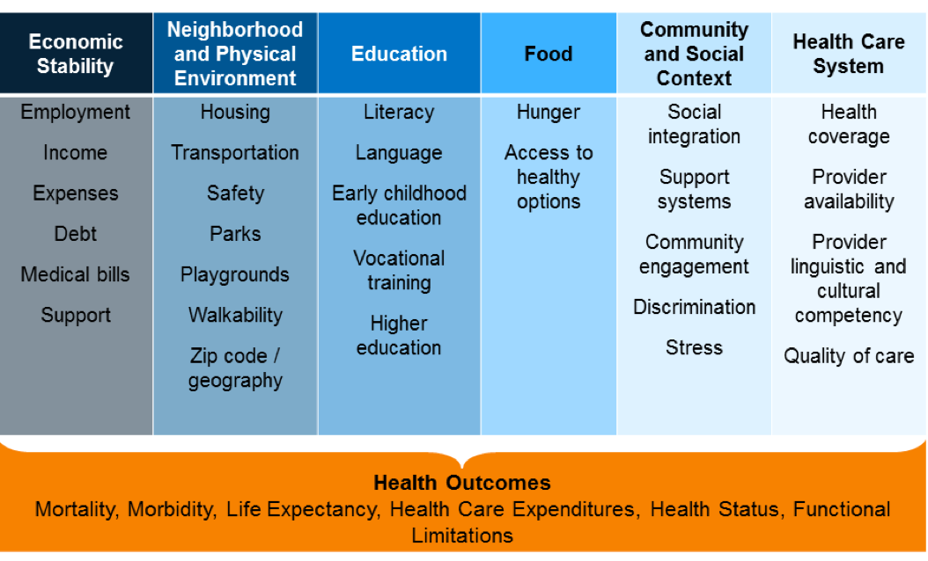
Another important part of data: social determinants of health (SDOH)

